Slide 2
CBCA and more – Supporting your connection to story - Jackie Hawkes and Honor White – August 2015
CBCA and more -
supporting your connection to story

Slide 3
CBCA and more – Supporting your connection to story
Happy 70th Birthday
Celebrate from August 2015 – August 2016
* Children’s Book Council of Australia established in Sydney November, 1945
* first annual Book of the Year Award, 1946

Slide 4
CBCA and more – Supporting your connection to story
AIMS
* promote quality literature for young Australians
* support Australian book creators
* promote the role of literature professions
* bring children and books together
* celebrate outstanding contributions to children’s literature
* promote book related activities
administer awards
(adapted from CBCA Notable Australian Children’s 2015)

Slide 5
CBCA and more – Supporting your connection to story
Membership of the CBCA NSW Branch
is open to anyone interested in
bringing children and good books together—parents, teachers, librarians, students, publishers, booksellers, journalists,
authors and illustrators.

Slide 6
CBCA and more – supporting your connection to story
Layers of CBCA
National
*Book Week themes, judging and awards
*Reading Time journal
Notes:
Layers and levels of CBCA each important considerations and contributions

Slide 7
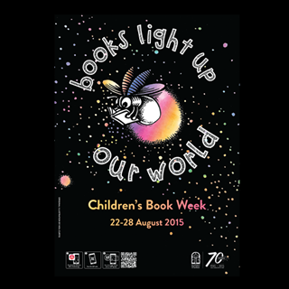
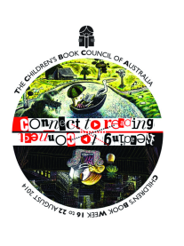
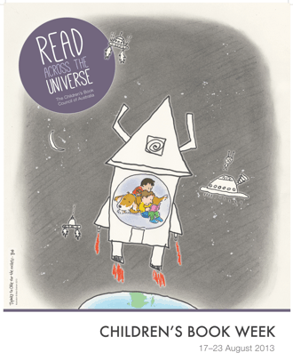
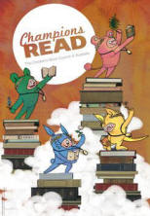
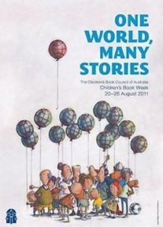
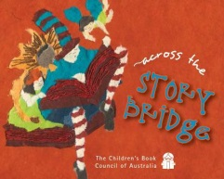
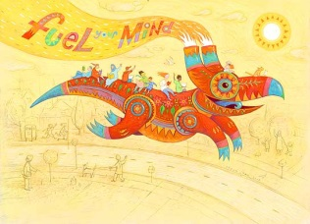
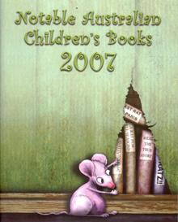
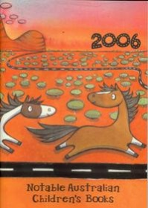
CBCA and more – Supporting your connection to story
Book Week themes
Notes:
Children’s Book Council established in Sydney 1945. WW2 had curtailed local production. First awards November, 1946
Women received a camellia and the men a handshake, the prizes have improved since then!

Slide 8
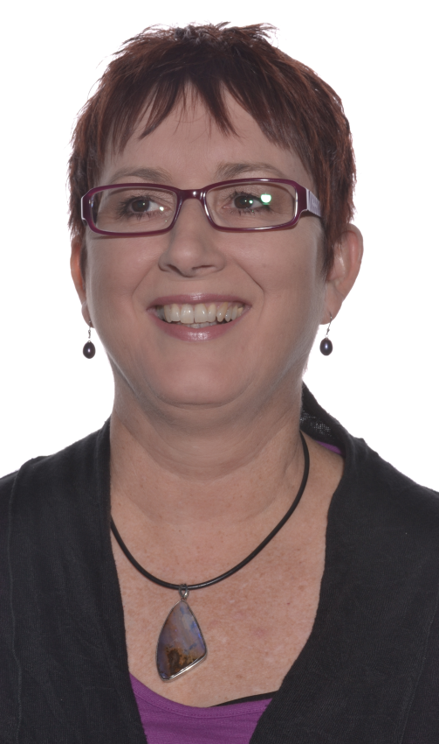
CBCA and more – Supporting your connection to story
Book of the Year Judging
NSW Judge – Cathie Tasker
I am a reader. I love reading, assessing and sharing books, all books. I’ve wanted to judge the CBCA awards ever since I began to understand the CBCA and its role. The idea of reading hundreds of books, assessing them and talking about them with like-minded people is exciting.
http://readingtime.com.au/judges-views/
Notes:
Judging is being modified so judges will no longer have to read every book in every category.
400 books submitted for the 2015 categories. Younger readers category had the most entries > 130.

Slide 9
CBCA and more – Supporting your connection to story
Book of the Year categories
- Book of the Year: Older readers
- Book of the Year: Younger readers
- Book of the Year: Early childhood
- Picture Book of the Year
- Eve Pownall Award for Information Books
Notes:
Definitions and age appropriateness is often open to discussion

Slide 10
CBCA and more – Supporting your connection to story
Awards and quality fiction
Some criteria
Implied readership under the age of eighteen
Literary merit, cohesive use of literary elements, appropriate language
Regard for aesthetic qualities of language
Originality
Overall production, quality and design
Graphic excellence
Accuracy in keeping with current state of knowledge
adapted from CBCA Notable Australian Children’s Books 2015
Notes:
Honor – quality literature – point kids in the RIGHT direction.

Slide 11
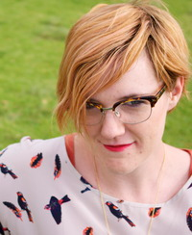
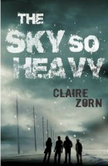
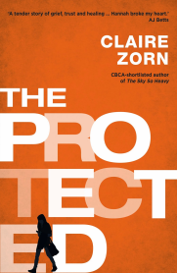
CBCA and more – Supporting your connection to story
Claire Zorne
on writing for older readers
The world is a dark and difficult place, teenagers are going to know this from walking down the street. It isn’t going to be sprung on them by a book.
Teens are going to be offered many means for navigating the uncertainties of adolescence. I would rather this stuff be in the hands of thoughtful, considered writers than corporations or marketers whose only concern is how to make a profit from them. ( from CBCA NSW iRead 4, 2014)
Claire’s short listed books include
The sky so heavy and The protected.
Notes:
Short listed authors perspectives. Queries of suitability of topics for older readers. Responsible and quality authors.

Slide 12
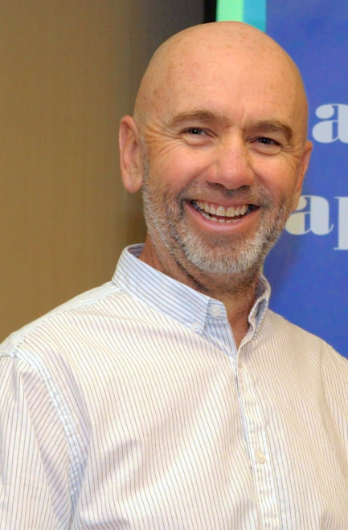
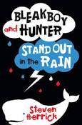
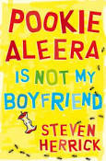
CBCA and more – Supporting your connection to story
Steven Herrick - As an author, the only skill, the only sense of power I have is to write about a world where I want to live, where I want my children to grow.
I enjoyed spending time in the pages of Bleakboy – I hope, in a small way, the characters remind us of what’s valuable in our society.
(from CBCA Notable Australian Children’s Books 2015)
Steven’s recent short listed books include:
Pookie Alera is not my boyfriend and Bleak Boy and Hunter Stand out in the Rain
Notes:
Our society between the pages

Slide 13
CBCA and more – Supporting your connection to story
What makes a great book?
‘With words and pictures, words alone, or no words at all,
I climbed thyme-filled hills and cantered through a midnight forest,
I felt the pain of leaving home and knew the colours of one child’s dreams.
I laughed with those whose mistakes were also my own
And wondered anew at life.‘ Yvonne Low - Author and Illustrator
A great picture book is one you lend out because you are proud of it but are scared won’t be given back. Once it has become a childhood memory you search the Internet for a second hand copy. Later, when you are an author/illustrator yourself you wished you’d created it. Liz Anelli - Author and Illustrator
Finding a great book is like meeting a fascinating person. More than story or character or theme, it's the author's voice or the illustrator's style that draws me in - what they notice, how they choose and combine words and lines and colours and design to express
what they know. John Bell - Author
Notes:
Every one has an opinion of what is right for them. Opinions change each time we read.

Slide 14
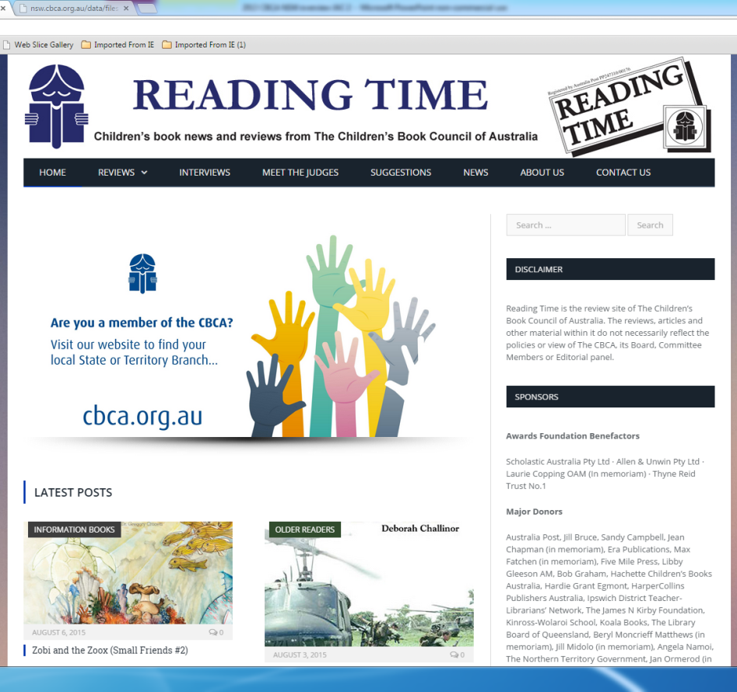
CBCA and more – Supporting your connection to story
CBCA Reading Time online - http://readingtime.com.au/
*Reviews
*Interviews
*Search
*Latest Posts
*Sign up for newsletter
*Categories
*Recent posts *Recent Comments
Notes:
Open to all. Updates can be sent to you via email notice weekly. Authoritative reviews.

Slide 15
CBCA and more – Supporting your connection to story
Layers of CBCA
STATE
CBCA NSW Branch
*Publications
*Events
*Programs
*Merchandise
*Local authors/ illustrators
*Website
http://nsw.cbca.org.au/index.php
"
Notes:
Core events and focuses through out the state.

Slide 16
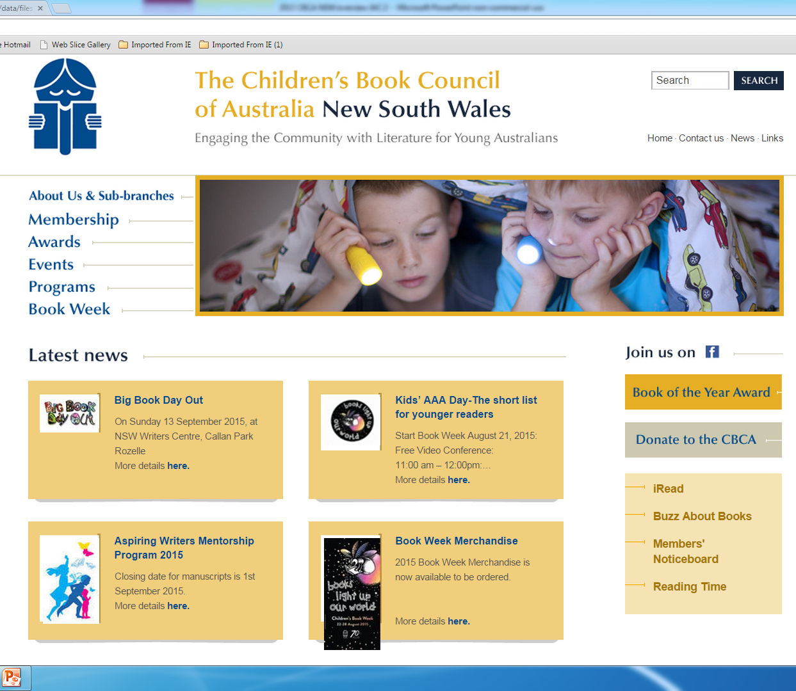
CBCA and more – Supporting your connection to story
Latest news *
*iRead
*ABAB All the Buzz About Books
*Members
Noticeboard
*Reading Time
CBCA NSW Branch Website - http://nsw.cbca.org.au/index.php
Notes:
Updates coming for the website, but plenty of updates regulalry

Slide 17
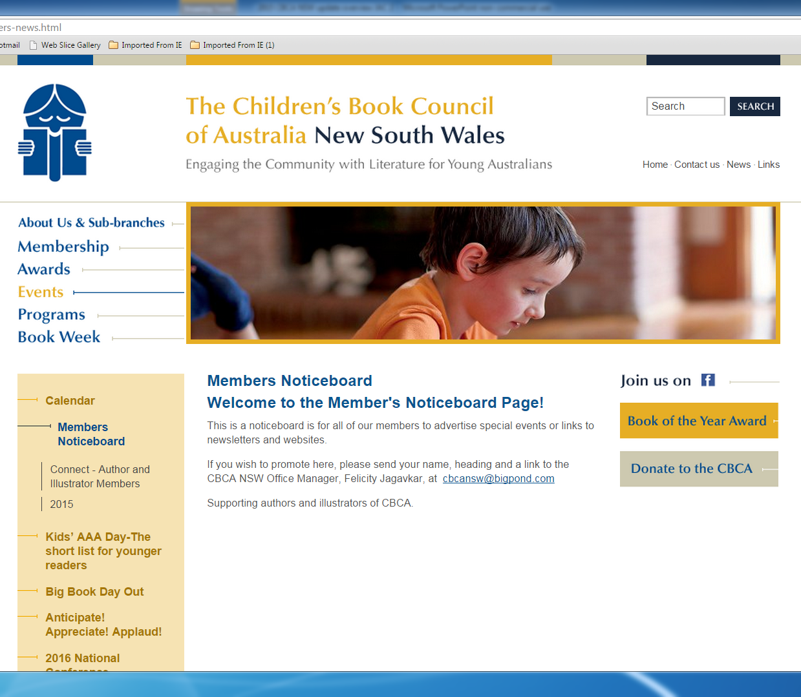
CBCA and more – Supporting your connection to story
*MEMBERS NOTICEBOARD
Calendar
Members noticeboard
CONNECT – author
and Illustrator members
http://nsw.cbca.org.au/pages/members-news.html
Notes:
Members noticeboard – up to date happenings. Absolutely DO check out the A / I blogs and websites.

Slide 18
CBCA and more – Supporting your connection to story
CBCA NSW Publications
iRead - iRead showcases articles across
the range of amazing things that are happening
in the world of children's literature.
All the Buzz About Books – ABAB includes articles, competitions, updates and activities related to great Australian authors, books and illustrators.
Notes:
Available on line, topics growing each issue. Check both for lots of ideas to adapt for your readers.

Slide 19
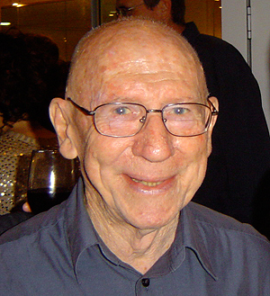
CBCA and more – Supporting your connection to story
CBCA NSW Branch Special Events
Maurice Saxby Lecture - 2015
The 2015 Maurice Saxby Lecture was delivered by Libby Gleeson at the University of Sydney. To view a report: click here . Previous speakers have included Robyn Ewing and Mark Macleod. This lecture is held every two years.
Maurice Saxby Memorial
On Monday January 19, 2015 at the Grat Hall at Sydney University a service was held to honour the achievements of Dr H Maurice Saxby AM, who worked tirelessly and passionately to promote the importance of books in a child’s life and quest for literacy.

Slide 20
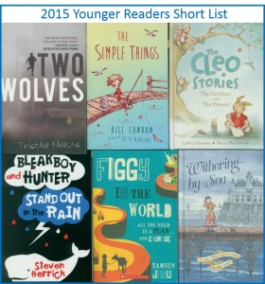
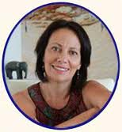
CBCA and more – Supporting your connection to story
CBCA NSW invites you
to start Book Week with
a FREE VIDEO CONFERENCE.
August 21, 2015
KIDS AAA - Anticipate! Appreciate! Applaud!
the short list for younger readers with students from
Sandy Beach PS and Harrington Park PS
as they join Sue Whiting to review and discuss
the titles in the 2015 short list for Younger Readers.
Sign up through DART on http://goo.gl/j1qXmf
Notes:
City and country kids with sophisticated interpretations of a very mixed category of winners. Register NOW!

Slide 21
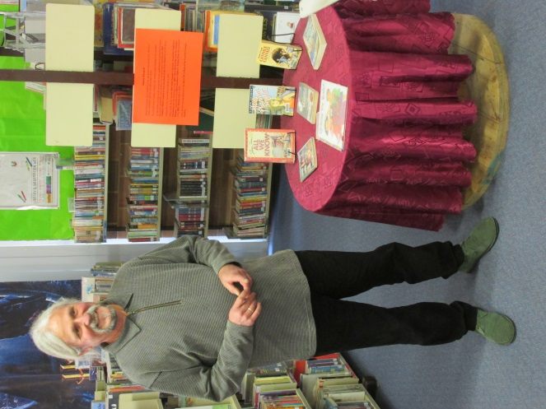
CBCA and more – Supporting your connection to story
Kids AAA 2014 with Simon French
City and country schools connecting to each other, | sharing opinions about quality literature with a “real” author. | and using technology to discover ideas about reading and writing.
Just seeing Simon was amazing, but talking with him was so great, I can’t think of a word for it. - Spencer | When it started, I was a little nervous, but overall happy. - Siobhan | Simon is a very interesting man who told us many stories and inspired us. He is a great role model. – Hannah | It was a city - country school video conference. Overall the day was amazing and I would happily do it again. - Claire

Slide 22
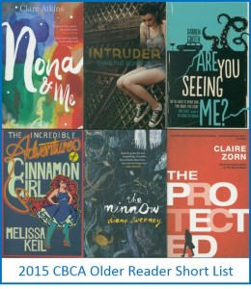
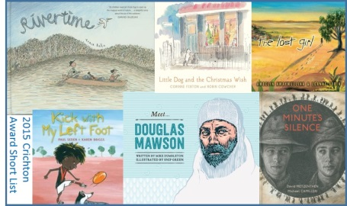
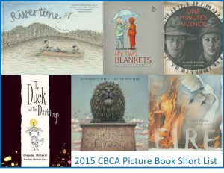
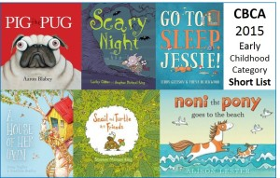
CBCA and more – Supporting your connection to story
Notes:
Whatever the theme, there are millions of ideas to share, adapt, build, enjoy as books light up our world every day

Slide 23
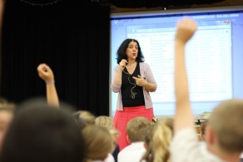
CBCA and more – Supporting your connection to story
Author and Illustrator visits
Sophie Masson – Book Week often sees a little army of writers banging the drum for books and writing in schools all around the nation. But anytime is perfect for authors to connect with kids and their teachers by spinning stories, telling inside jokes, sharing personal anecdotes and showing how to enjoy the whole writing process.
Notes:
Book Week IS about sharing and exposing kids to the story creators

Slide 24
CBCA and more – Supporting your connection to story
September 12 | Lots of authors telling stories Sub branches exhibits Craft make and do Rozelle PS music group Illustrators showing their craft A big raffle to win Food Jumping castle for littlies Book binder to visit A pixie gloating by!! Bring a blanket and have a picnic And MORE
Notes:
Literature festival in Rozelle

Slide 25
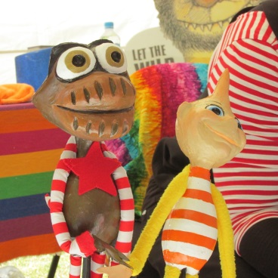
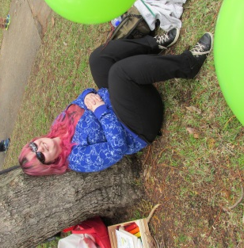
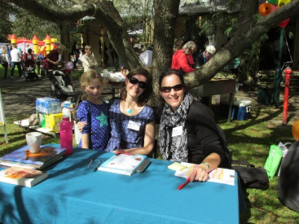
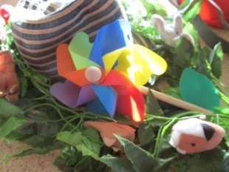
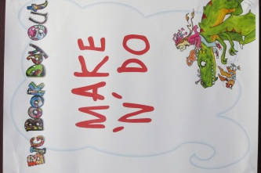
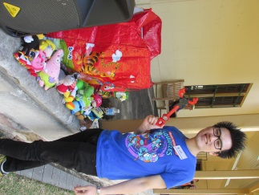
CBCA and more – Supporting your connection to story
Meet your favourite authors, see an illustrator in action, marvel at magic and laugh in the story tent. Unleash your creativity in the Make and Do area, burn off some energy on the jumping castle and relax in the sunshine. Read good books.

Slide 26
CBCA and more – Supporting your connection to story
CBC2U * Children's Book Creators To You
helping bring kids, schools and libraries
in disadvantaged areas together
with authors and illustrators

Slide 27
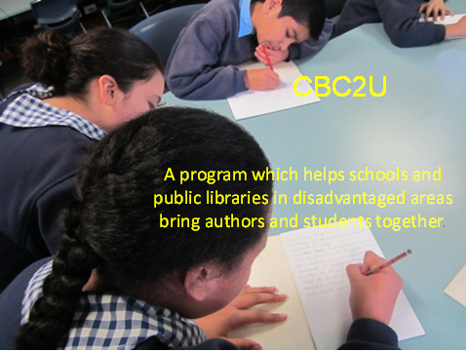
CBCA and more – Supporting your connection to story
CBC2U CBC2U
Children’s Book Council to YOU
In 2014 20 primary and high schools hosted author visits
by 12 authors.
The visits took place in Western and South Western Sydney, Lismore, Moruya, Moree and Leeton.

Slide 28
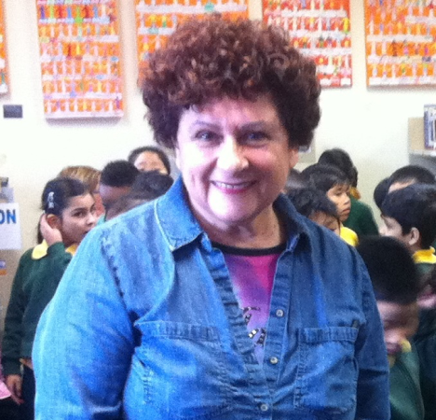
CBCA and more – Supporting your connection to story
CBC2U - What students said:
“I was surprised she (Toni Brisland) came because I never have really seen a real author.” Cameron, Harcourt Public
“It helps HSC students to study when authors give us their wisdom and help us.” Nathaniel, Narranadera High School

Slide 29
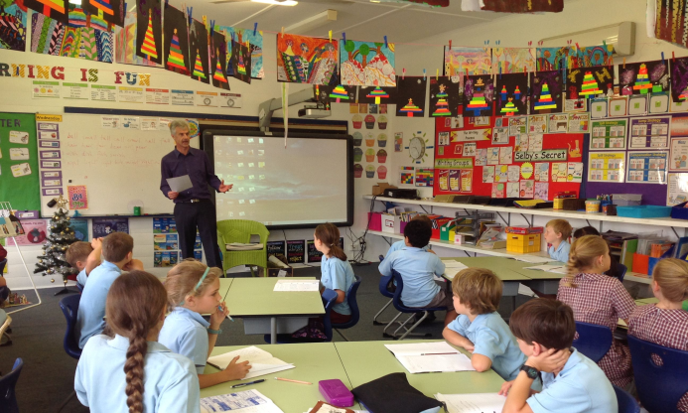
CBCA and more – Supporting your connection to story
“How fortunate can one be, studying for the HSC, reading a text in depth …and then…meeting the author and conversing with them! We do not often get the chance to have authors visit us in the country.” English Teacher, Narranderra High School (JC Burke visit) | * CBC2U * What Teachers Said | “It was delightful to witness students, especially several who are normally rather reticent, taking a leap into both their artistic souls and out into their creative writing spaces. The pride they felt in their accomplishments was heart-warming.” Lisa Fahy, Principal Wyrallah Public School

Slide 30
CBCA and more – Supporting your connection to story
Aspiring Writers Mentorship Program
Charlotte Waring Barton Award for new authors
CBCA NSW and Penguin Random House Australia have joined forces to foster aspiring writers. The 2015 winner will receive a comprehensive mentorship including:
3 x 2 hour sessions with a Penguin Random House author.
1 x 1 hour session with a Penguin Random House editor.
1 x 1 hour session with Penguin Random House Publicity and Marketing Department.
1 x 1 hour session with a Penguin Random House publisher.
Closing date for manuscripts is 1st September 2015.

Slide 31
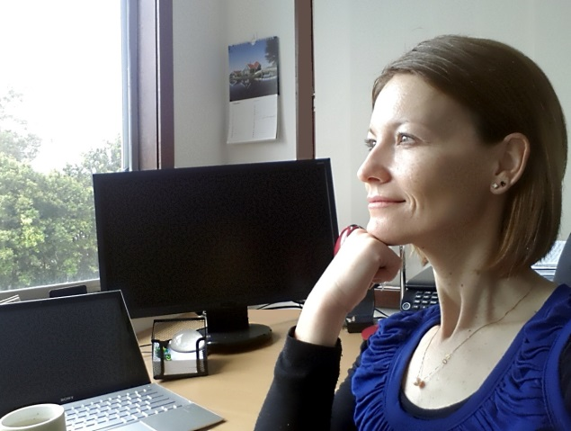
CBCA and more – Supporting your connection to story
Aspiring Writers Mentorship Program
All emerging writers dream
of having their entire manuscript
read by a publisher - every last word.
And then to hear them say
what they really thought. . .
It has been
the most brilliant and insightful experience.
. . . And while I still need to absorb everything,
I’ve found renewed enthusiasm
for all my writing projects. - Zoya Nojin 2013 in iRead 4, 2014
Previous winners include:
Michelle Cooper, J C Burke, Toni Brisland, Jacqueline Harvey, Oliver Phommavanh,
Aleesah Darlison, Kirsty Eager and Nathan Luff.

Slide 32
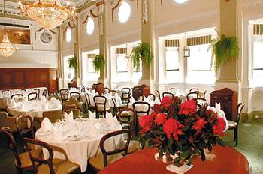
CBCA and more – Supporting your connection to story
The Lady Cutler Award and Dinner
presented for Distinguished Service to Children’s Literature, the accent being on ‘service’. A recipient of the award, then, will have given service well beyond his or her professional association with children’s literature.
The Charlotte Warring Barton Award for
Emerging Writer is awarded on the
same evening.

Slide 33
CBCA and more – supporting your connection to story
Layers of CBCA
CBCA NSW Sub branches
Variety of LOCAL happenings
Northern Sydney Sub-branch
Blue Mountains Sub-branch
Illawarra-South Coast Sub-branch
New England Sub-branch
Central Coast Sub-branch
Newcastle Sub-branch
Sydney West Sub-branch
Notes:
Local enthusiasm, hard work and energizing activities. Again plenty to adapt and join in with. Two NEW local groups.

Slide 34
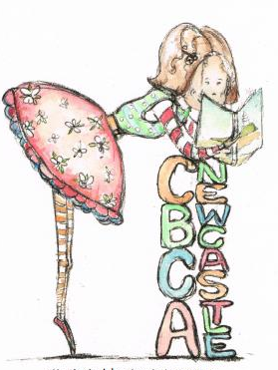
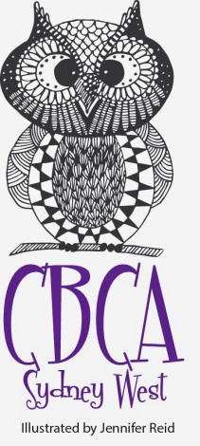
CBCA and more – Supporting your connection to story
CBCA NSW Sub branches
Blue Mountains Sub-branch
Northern Sydney Sub-branch
Illawarra-South Coast Sub-branch
New England Sub-branch
Central Coast Sub-branch
Newcastle Sub-branch
Sydney West Sub-branch
Notes:
Variety of local based activities, including sub branch logos from talented members

Slide 35
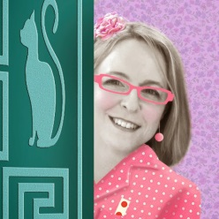
CBCA and more – Supporting your connection to story
Blue Mountains Sub branch
*dragon created by Narelda Joy, Illustrator
Next meeting September 12 - Lawson
*CONTACT - Sheryl Cootes, President Blackheath Public School Leichhardt St Blackheath 2785
Email – sheryl.cootes@det.nsw.edu.au
Notes:
Story. Literary Soiree, Book Week Lit quiz and a kids day next term,

Slide 36
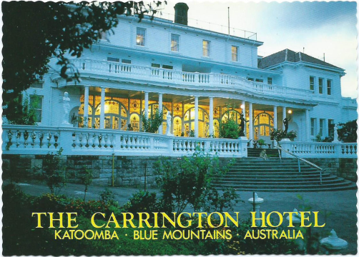
CBCA and more – Supporting your connection to story
EVENTS
* Literary Soiree @ The Carrington Hotel – Katoomba
with authors and illustrators Ben Wood John Bell,
Dawn Meredith, Narelda Joy, Freya Blackwood, Tobhy Riddell,
Michel Streich, Freya Blackwood, Beth Norling, Emily Rodda,
Catherine Jinx, Margaret Hamilton, Jenifer Govet, and more.
Kids’ Lit Quiz Australia and the Blue Mountains CBCA Sub branch
are holding a quiz to celebrate Book Week and give the kids a taste of the real quiz!
Friday 28th August 10am -12pm
Blackheath Public School
We are close to the station. Come and join the fun!

Slide 37
CBCA and more – Supporting your connection to story
Sydney West Sub branch
*owl mascot created by Jennifer Reid, artist and author
Next meeting –
Wednesday 9th September
at Narellan Library
*CONTACT – Rachel McIntosh, President
Email: rachel.president.cbcasw@gmail.com
Phone: phone 0438 464 484.
Sydney West Sub-branch
http://nsw.cbca.org.au/pages/sydney-west-sub-branch.html

Slide 38
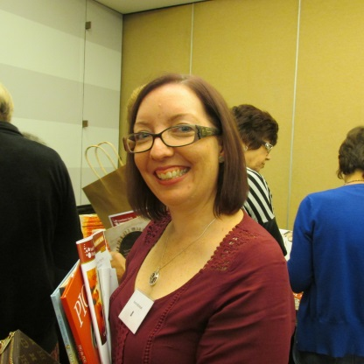
CBCA and more – Supporting your connection to story
We are excited to be working in partnership with Narellan Library
with its modern design, state of the art facilities including a professional sound recording studio, a technology room and
welcoming rooms to host our meetings.
Together we have great plans to bring
Children's literature
to the forefront in Western Sydney.
Our upcoming events include:
* BBQ fundraiser - Saturday August 15, at Masters Gregory Hills between 11.00 - 2.00
*NEXT MEETING – September 9 - reviewing the book week workshops and looking at enhancing partnerships with the Narellan Library and connecting to local pre-schools
and early education providers. We look forward to seeing you there.

Slide 39
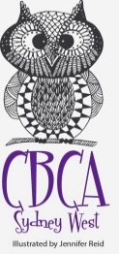
CBCA and more – Supporting your connection to story
Please join us in welcoming the NEW Children’s Book Council of Australia NSW Branch Inc. Sydney West Sub-branch http://nsw.cbca.org.au/pages/sydney-west-sub-branch.html For more details please contact Rachel McIntosh, President Email: rachel.president.cbcasw@gmail.com | Please join us in welcoming the NEW Children’s Book Council of Australia NSW Branch Inc. Blue Mountains Sub-branch Website url coming soon For more details please contact Sheryl Cootes, President Email: sheryl.cootes@det.nsw.edu.au

Slide 40
CBCA and more – Supporting your connection to story
LOOKING AHEAD
The 12th National Conference of the
Children’s Book Council of Australia
Date: 20 – 21 May 2016
Location: The Menzies Hotel, Sydney

Slide 41
CBCA and more – Supporting your connection to story
2016 CONFERENCE THEME:
READ: myriad possibilities
Books may not change our suffering, books may not protect us from evil, books may not tell us what is good or what is beautiful, and they will certainly not shield us from the common fate of the grave. But books grant us myriad possibilities: the possibility of change, the possibility of illumination.
Alberto Manguel

Slide 42
CBCA and more – Supporting your connection to story
THE END . . . AND THE BEGINNING
Please join with us in
Engaging the Community
with Literature
or Young Australians.
Happy reading always -
Children’s Book Council NSW Inc
Since 1945 – Your connection to story

Slide 43
CBCA and more – Supporting your connection to story

Slide 44
CBCA NSW :: Engaging the community with literature for young Australians

